Slide 1


Slide 2

Chapter 14
Enhancing Tables

Slide 3
Enhancing Tables
Change a table’s layout to reorganize its information.
Layout changes include adding and deleting columns and rows and merging and splitting cells.
To accommodate text, change cell size and work with cell margins and alignment.
Sort and calculate table data.

Slide 4
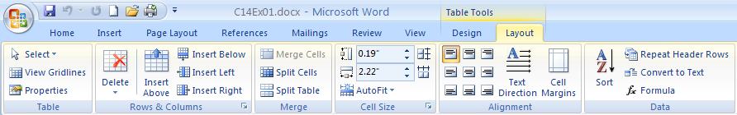
Changing Table Layout
When a table is selected or the insertion point is in a table cell, click the Table Tools Layout tab to display the options for changing the table layout.
You also can right-click a table to access some of the layout options.

Slide 5

Selecting with the Select Button
The Select button in the
Table group of the Table
Tools Layout tab enables
you to select a cell, row,
column, or the whole table.
To select a row or column, select a cell in the desired row or column, click the Select button, and then click Select Row or Select Column.

Slide 6

Inserting Rows and Columns
Insert one or more new rows or columns to accommodate new information you want to add to the table.
Use the Insert Above and Insert
Below buttons in the Rows &
Columns group of the Table
Tools Layout tab to insert a new
row relative to the cell holding
the insertion point.
Use the Insert Left and Insert
Right buttons in the Rows &
Columns group of the Table Tools Layout tab to insert a new column relative to the cell holding the insertion point.

Slide 7
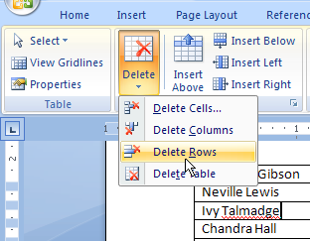
Deleting Rows and Columns
To delete a row or column, click in a cell in the row or column.
Click the Delete button
in the Rows & Columns
group of the Table Tools
Layout tab, and then
click Delete Columns
or Delete Rows.
Also delete the whole
table by clicking Delete Table.

Slide 8
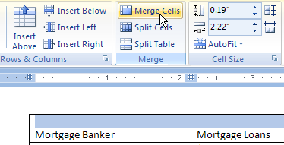
Merging and Splitting
Merging combines cells or tables, splitting divides a cell or table.
Select the cells to
merge, and then
click the Merge
Cells button in the
Merge group of the Table Tools Layout tab.
After you select a cell and click the Split Cells button, use the Split Cells dialog box to specify the number of new rows or columns.

Slide 9
Checkpoint
What tab do you use to change the layout of a table?
Name some examples of when you might want to insert or delete rows or columns in a table.
Name some examples of when you might want to merge or split table cells.

Slide 10
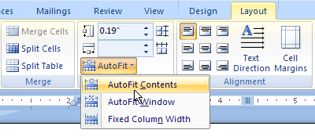
Customizing Cell Size
When you insert a table, all the cells are created with the same size.
Make entries in the Table Row Height and Table Column width boxes in the Cell Size group of the Table Tools
Layout tab to
specify a specific
row height or
column width.
Click the AutoFit
button in the same
group to make
column widths
adjust automatically
to fit the content.

Slide 11
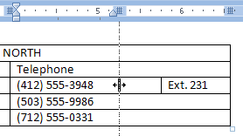
Customizing Cell Size
Drag the gridline to the right of a column to resize the column.
Drag the gridline at the bottom of a row to change the row height.

Slide 12
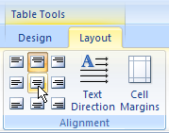
Changing Cell Alignment
You can specify both the horizontal and vertical alignment of text in cells.
Select the cell(s) to align, and the desired alignment choice in the Alignment group of the Table Tools Layout tab.

Slide 13
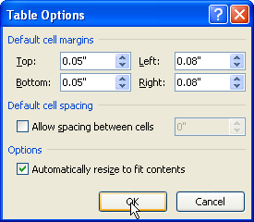
Changing Cell Margins
Margins within a cell determine the amount of space between the cell text and the cell gridlines or borders.
Top and bottom cell margins are 0 inches by default, and left and right margins are .08 inches.
Select the cells for which
you want to change margins,
and then click the Cell
Margins button in the
Alignment group of the
Table Tools Layout tab.
Specify the desired margins
in the Table Options dialog
box, and click OK.

Slide 14

Changing Text Direction
Text in cells can be formatted to appear vertically, either running from top to bottom or bottom to top.
Select the cell(s) to reformat, and then click the Text Direction button in the Alignment group of the Table Tools Layout
tab to cycle through the various
alignment choices.

Slide 15
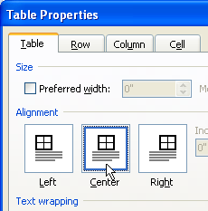
Aligning a Table
Tables align at the left margin by default.
Click the Properties button the Table group of the Table Tools Layout tab to open the Properties dialog box.
Click the desired alignment on the Table tab, and click OK.

Slide 16
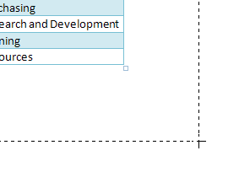
Resizing and Moving a Table
Move the mouse over the
table, and drag the resize
handle at lower-right to
change the table size.
Move the mouse over the
table move handle in the
upper-left corner of the
table so that the mouse
pointer changes to a four-headed arrow, and drag the table to move it.

Slide 17
Checkpoint
Why might you need to change cell size?
Name at least one method for changing column width.
Name at least one method for changing row height.
How do you change the alignment of text in cells?
How do you change table alignment?
How do you resize or move a table?

Slide 18
Converting Text and Tables
If text is separated with tabs or commas, you can convert it to a table.
Select the text, click the Table button in the Tables group of the Insert tab, and click convert Text to Table.
Select the correct number of rows and columns in the Convert Text to Table dialog box, and click OK.
To convert a selected table back to text, click the Convert to Text button in the Data group of the Table Tools Layout tab. Specify the desired separator in the Convert Table to Text dialog box, and click OK.

Slide 19
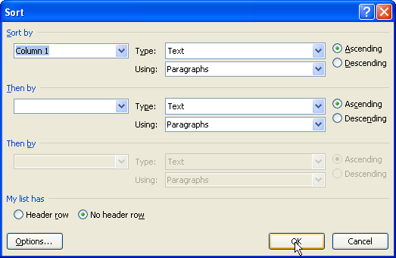
Sorting Table Contents
Select table cells and sort their text or numeric data to change the order of the information.
Click the Sort
button in the
Data group of
the Table
Tools Layout
tab.
Specify the
column to sort
and other Sort
settings, and
click OK.

Slide 20
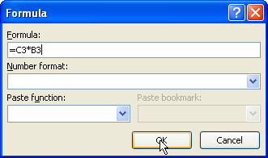
Calculating in a Table
Create a formula to add, subtract, multiply, or divide data, in addition to using functions for more complex calculations.
Click in the cell where you want to insert the formula. Click the Formula button in the Data group of the Table Tools Layout tab.
Enter the formula in
the Formula text box,
and use the Paste
function drop-down
list to insert
a function.
Click OK to finish the
formula.

Slide 21
Calculating and Recalculating
Refer to cells by column letter and row number in a formula.
Enter an equals sign to start the formula.
Use these operators:
  Add +
  Subtract -
  Multiply *
  Divide /
Select the formula and press F9 to recalculate it when values in the table change.

Slide 22
Checkpoint
When might you need to convert text to a table?
When might you need to convert a table to text?
How do you sort table text?
Explain how to open the Formula dialog box.
What is a function?
What key do you press to recalculate a formula?

Slide 23
Wrap Up
The Table Tools Layout tab contains the options for working with cell and table layout.
Use the Select button to select rows and columns.
Insert and delete rows and columns to make significant changes to table contents.
Merge cells to combine them. Split cells to divide them.
Drag the right gridline or border to change column width and the bottom gridline or border to change row height.
Use buttons in the Alignment group of the Table Tools Layout tab to change the vertical and horizontal alignment of text in cells.
Adjust cell margins to add white space around cell contents.
Move, align, and resize a table as needed.
Sort table data to change its order.
Enter a formula in a cell to perform calculations on table data.

